Slide 1
CLOSING THE WORKFORCE DIGITAL SKILLS GAP
Sprint 2 kick-off call
Routes to 20 million
May 2026
Notes:
PAUL

Slide 2
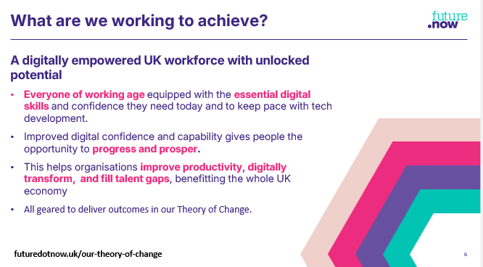
Welcome to Sprint 2!
10 weeks
Second sprint of the year
26 May – 28 July
Today is about progress, priorities and getting set up for success
Notes:
Today is the getting the teams already live – sharing prioritiyes and reminding priorities for the next 10

Slide 3
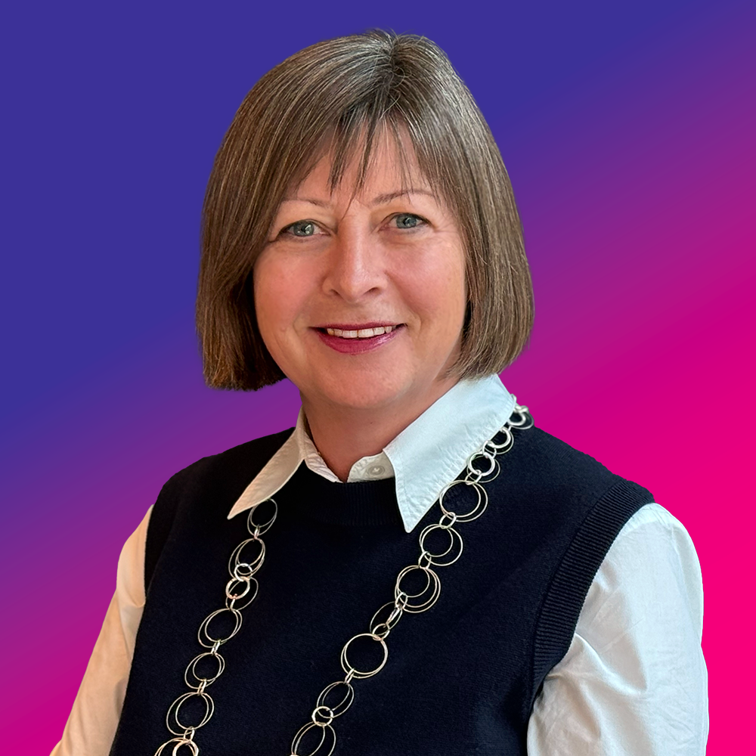
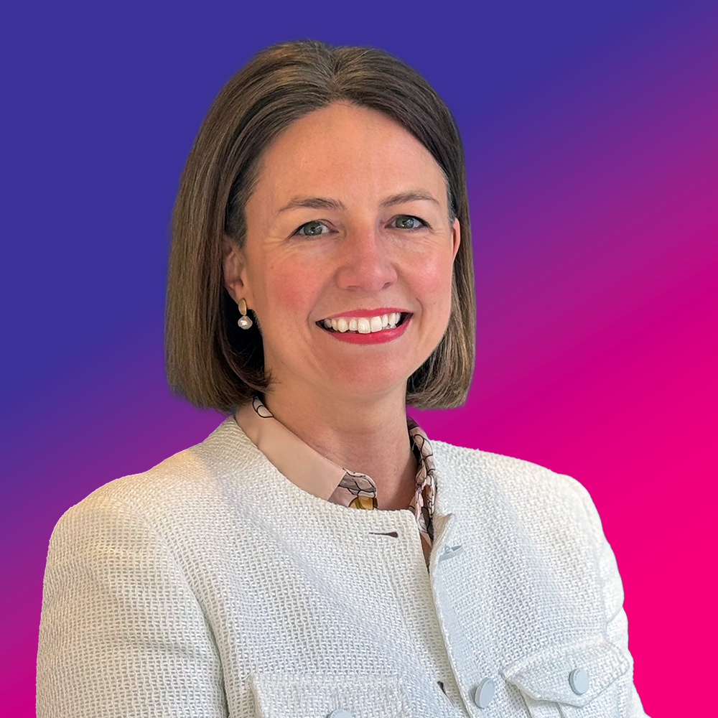


Team on the call today
Today’s Agenda
01
02
03
04
Welcome and introduction
Strategy and progress
Workstream updates
How to get involved
Liz Williams MBE
Holly Chate
Chief Executive
Chief Operating Officer
Angie Clement
Chris Andersson
We will be recording today’s call – please go on mute unless presenting
Business Manager
Comms & Campaigns Manager
Notes:
PAUL

Slide 4
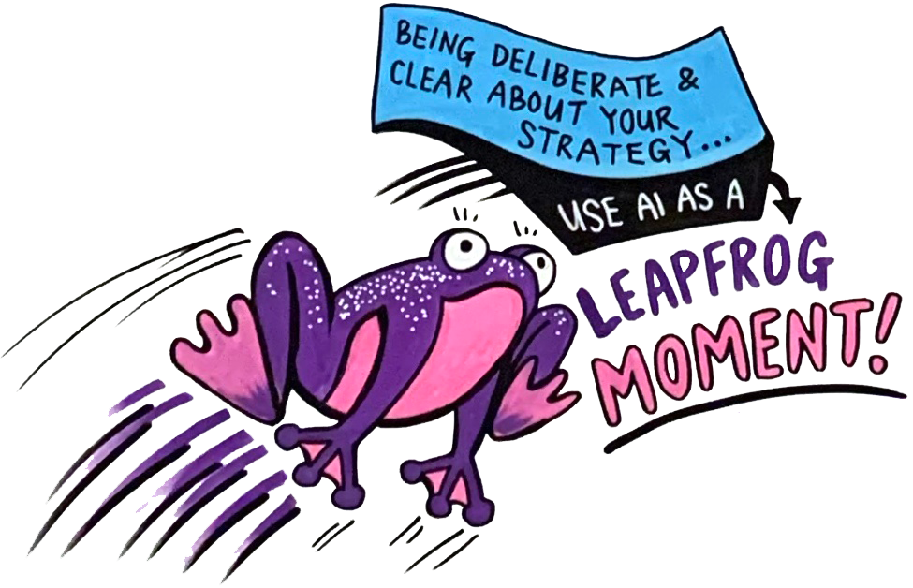
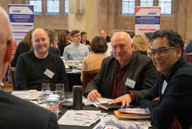
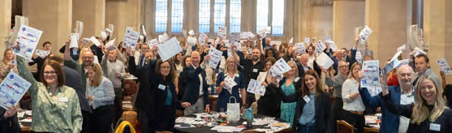
One day,
150+ leaders,
new faces, huge amounts of energy
and engagement, and
5 key themes:
Essential digital skills are the bedrock of a future-fit workforce
Digital confidence directly affects employability and economic outcomes
AI will widen the divide unless foundations are fixed first
Both a learning challenge and a leadership challenge
Solutions exist, collaboration makes them scalable
The UK will not unlock the benefits of AI, automation or digital
transformation unless it first fixes its essential digital skills foundations

Slide 5
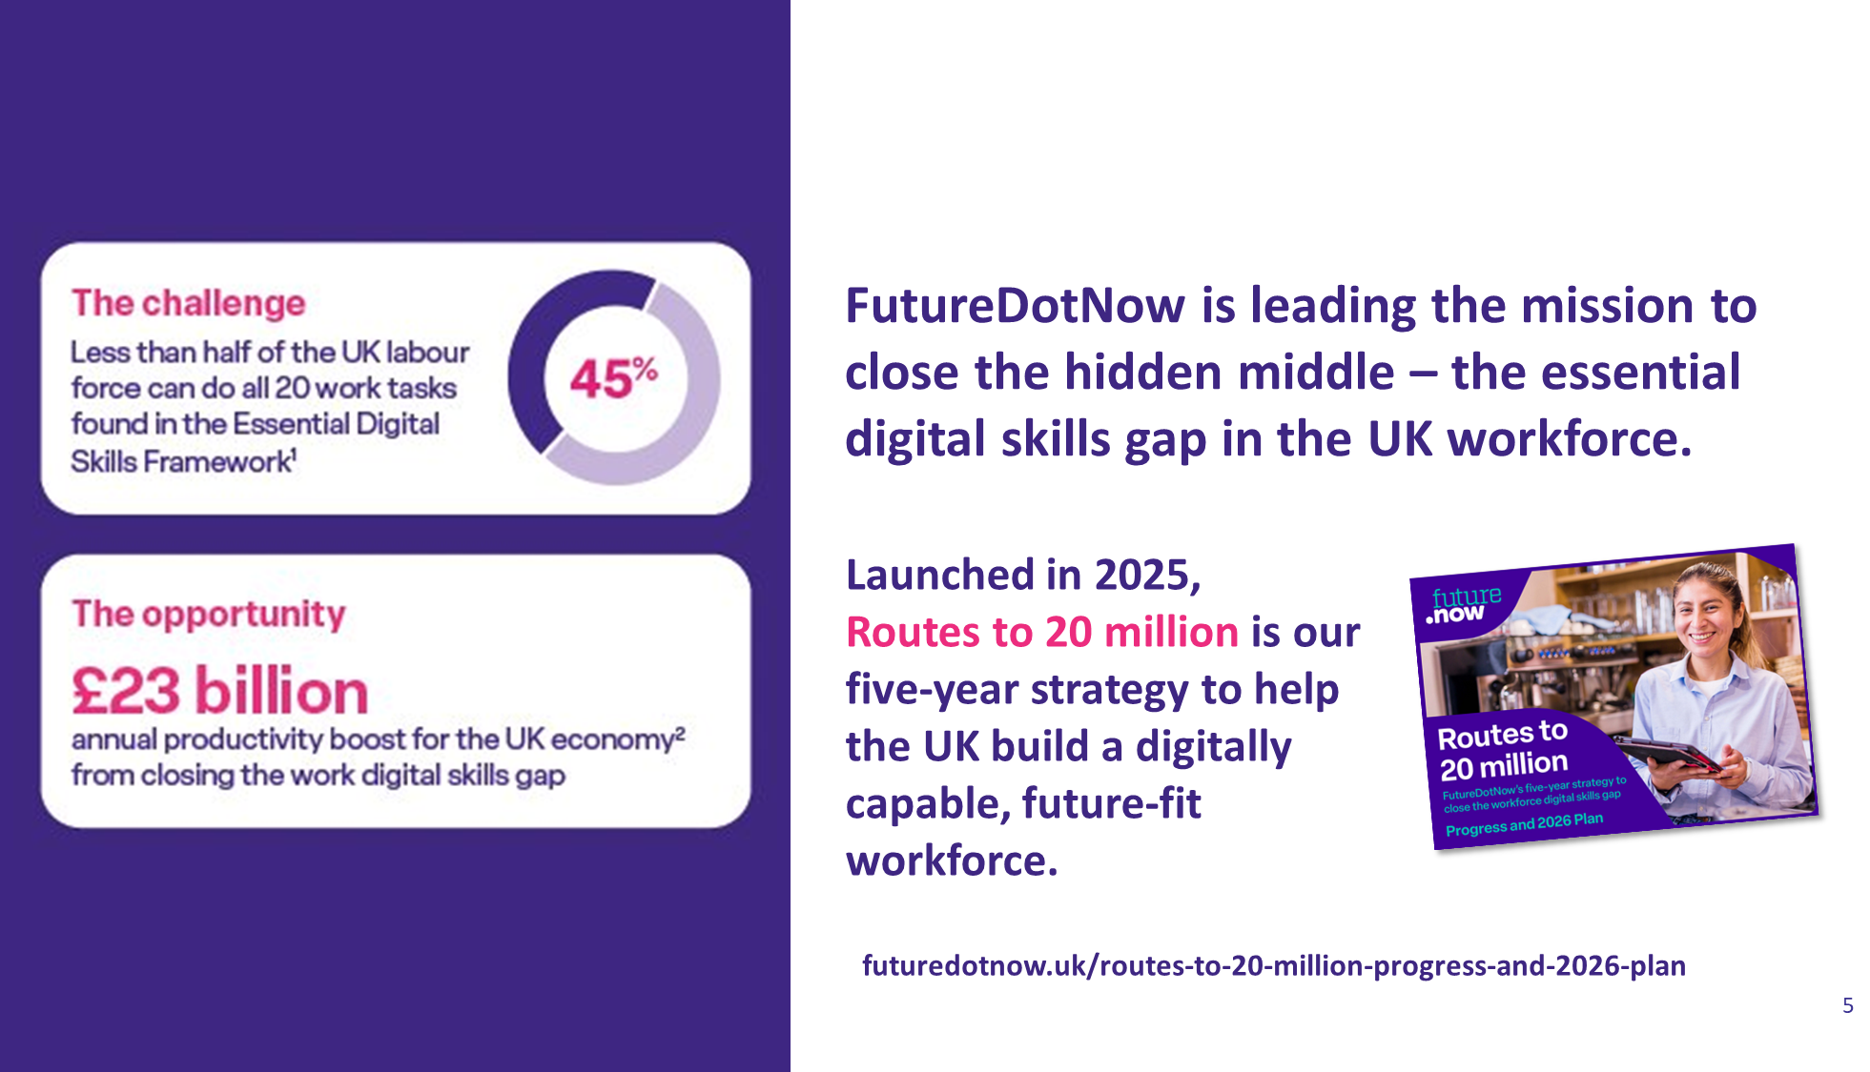
Two key themes in 2026
All about scale!
Engage more businesses – through sectors and key communities
Making action easier - Providing tools & solutions for business to act, while continuing to solve systemic issues
Notes:
We’re over a third of the way through the year. Sprint 1 completed, Summit delivered, with two more sprints to deliver this year to make impact on essential digital and AI skills.
Lots of progress – we’ll remind you of some today – lots more to do, which is where most of today will be focused as we look across the 2026 delivery plan and individual workstream priorities for sprints 2 and 3.
Let’s start with a whistle stop review of where we are now….

Slide 6
What does good look like by end of Sprint 2?
What we know now…each workstream will be refining over first few weeks of this sprint
ENGAGING MORE BUSINESSES | Workstreams
Awareness and action growing across sectors, with a further 2 sectors live and with action plans. (New Strategic Projects Delivery Manager starts 22 Jun) | Sector mobilisation
Significant scale on charter signatories and members – four live sectors are a key route | 4 x Sector workstream
Stakeholders working with young people understand the EDS imperative and are bringing this into their work | Breaking cycle for young people
Work ready report launched, and using to campaign with key audiences for NEETs /employability – DWP, Alan Milburn. Toolkit to replicate at scale in development and launched for Sprint 3. | Not in work test & learn Place Campaigning
MAKING ACTION EASIER
Organisational Maturity Framework developed further – ultimate goal is to encourage more organisations to use it to benchmark their position. | Benchmarking digital maturity
Existing bank of resources reviewed and prioritised to create curated journeys against the maturity stages (New Marketing and Membership Growth Lead starts 22 Jun). | Tools and Solutions
New Accreditation & Badging workstream stood up building on learning from Employability pilot and responding to pull for ways to accredit and motivate learners. Continued focus on future-fit framework, including DSIT ownership, AI skills and wider ecosystem adoption | Accreditation and Badging Future-fit framework
Never forgetting that small and medium enterprises are a really critical audience
Notes:
Liz

Slide 7



Report launching Thursday!
Essential Digital Skills & AI Employability Project.
This rapid proof of concept set out to test whether equipping jobseekers with essential digital and AI skills could boost digital confidence, capability, and job-readiness, and ultimately improve an individual’s chances of getting a job. As part of this work, Accenture also engaged with employers to gather views on expectations of new recruits, critical skills gaps and how the workplace is changing.
Project was delivered in partnership by FutureDotNow, Cosmic and Accenture, funded by the Digital Inclusion Innovation Fund.
Project Delivery with learners – completed.
Participants receiving integrated Essential Digital Skills and AI training were almost twice as likely to secure employment (26% v 14% in the control group).
Proof-of-concept testing completed.
Grant work finalised and sent to our sponsors at DSIT.
Early findings shared at the Summit
Report will launch Thursday 28 May
Toolkit now under development – how to take the learning and replicate – for summer launch.
This work is potentially a powerful lever for policy, funding, and employer engagement. Steps already taken to embed in campaigning work.

Slide 8
Pathways: Engaging
more businesses
Let’s hear about the workstreams…
Notes:
HOLLY

Slide 9
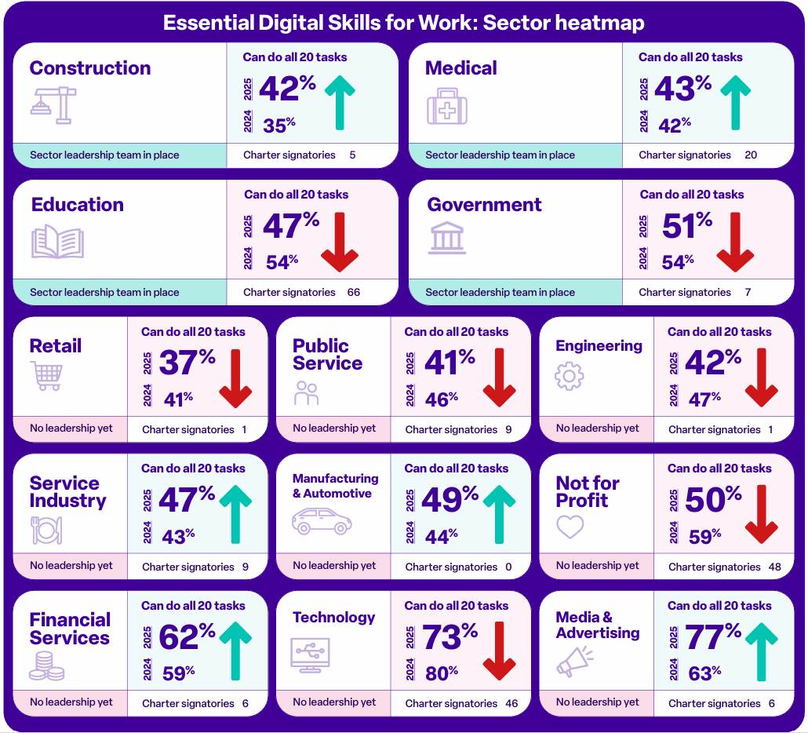
Engaging more businesses through Sectors
Our aspiration is for every sector to have an action plan. Today, four out of 13 have an action plan in place. Today, we have 240 Charter signatories, and 25 members
The ask of each sector team
To make the workforce digital skills gap a recognised priority across their sector
Grow sector-wide commitment through Charter signatories and membership.
Position FutureDotNow as a trusted partner for workforce upskilling
Demonstrate what good looks like through employer-led action in their organisations
New look heatmap launched.
Website update coming soon
Notes:
we open sprint 2 with 5 (of 13) sectors active with leaders in place owning development and delivery of the sector action plan or in a scoping phase.
TechUK confirmed for sprint 2 to start to stand up the tech sector action plan.
The sector mobilisation strategy workstream also made progress in sprint 1 with the development of the mobilisation best practise guide with work to do in sprint 2 to refine this and confirm resourcing from Marsh.

Slide 10
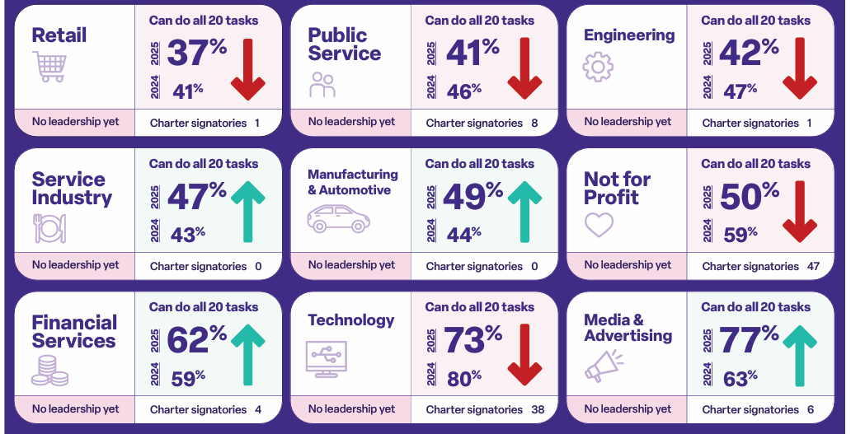
Our aspiration is for every sector to have an action plan.
Nine are still to be activated.
NB: Sector classification from the Lloyds Bank Essential Digital Skills Report

Slide 11

Activating the remaining sectors
Work in sprint 1 to build sector mobilisation best practice guide for prospective sector leaders.
End of sprint 1 workshop inputs to improve the MVP
  Use desk research to do first pass sector segmentation
  Ask leaders in the sector to review/validate as route to open discussion
  Insights gathered on resources most valuable to sector leaders and what has been built to date
Open question: which sector or sectors to prioritise next for most impact?
Since the end of Sprint 1, FutureDotNow has:
Built out a summary slide for each sector showing the current headline position, including the sector segmentation, Charter signatories and membership.
Secured techUK as first co-lead for technology
Opened discussion with the City of London regarding Financial Services
Sector mobilisation will be led by FutureDotNow (with Marsh) and the focus of new PM once in post (starting 22 June)

Slide 12
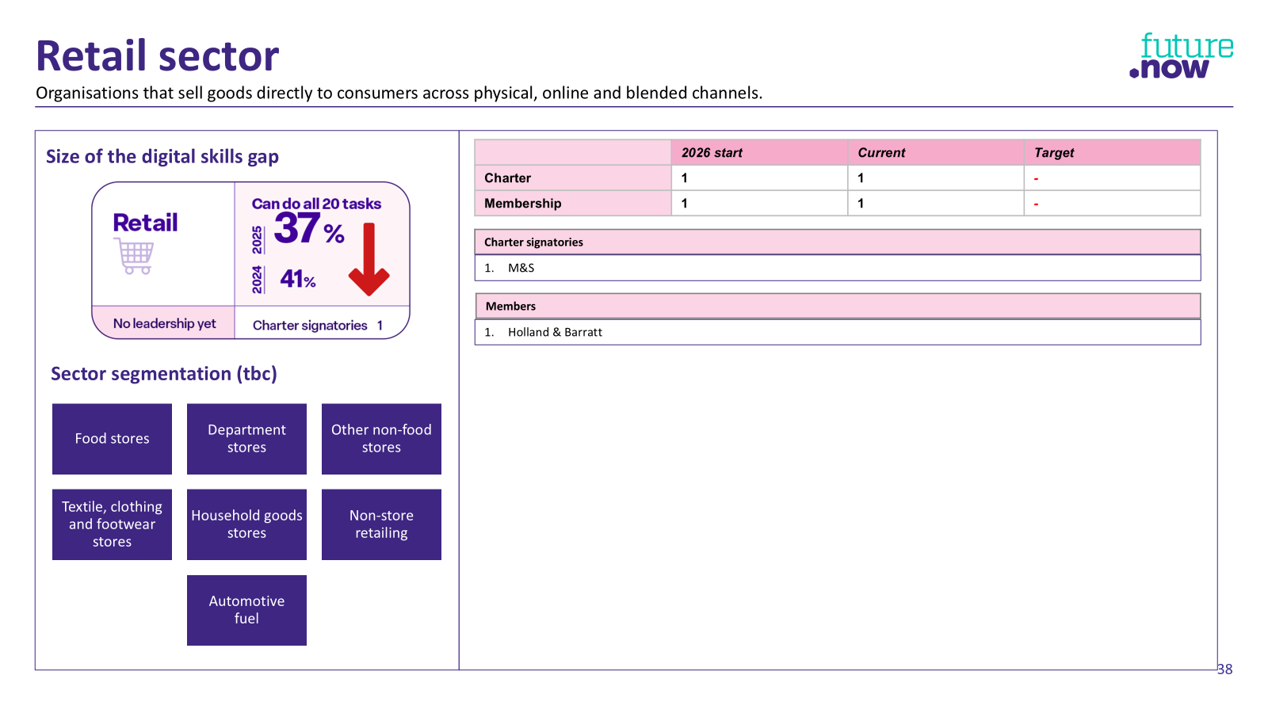
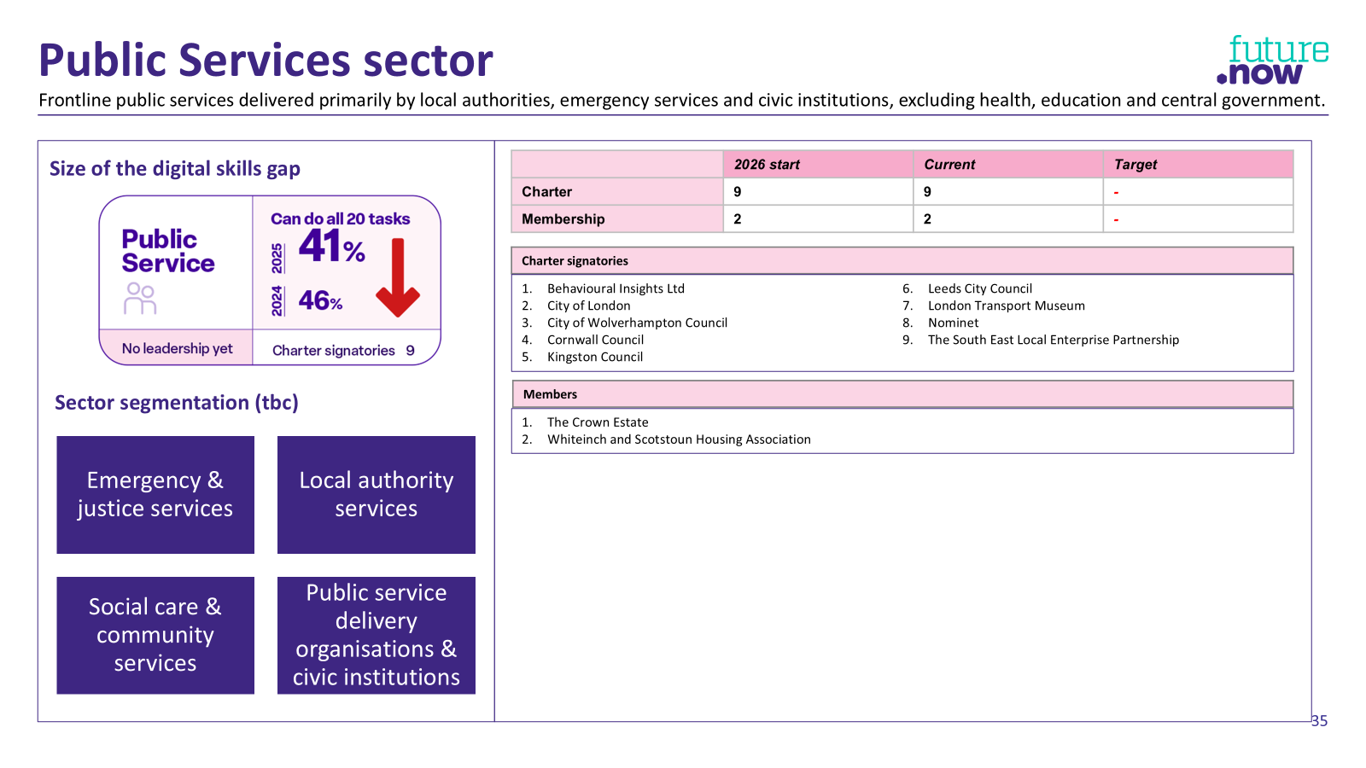
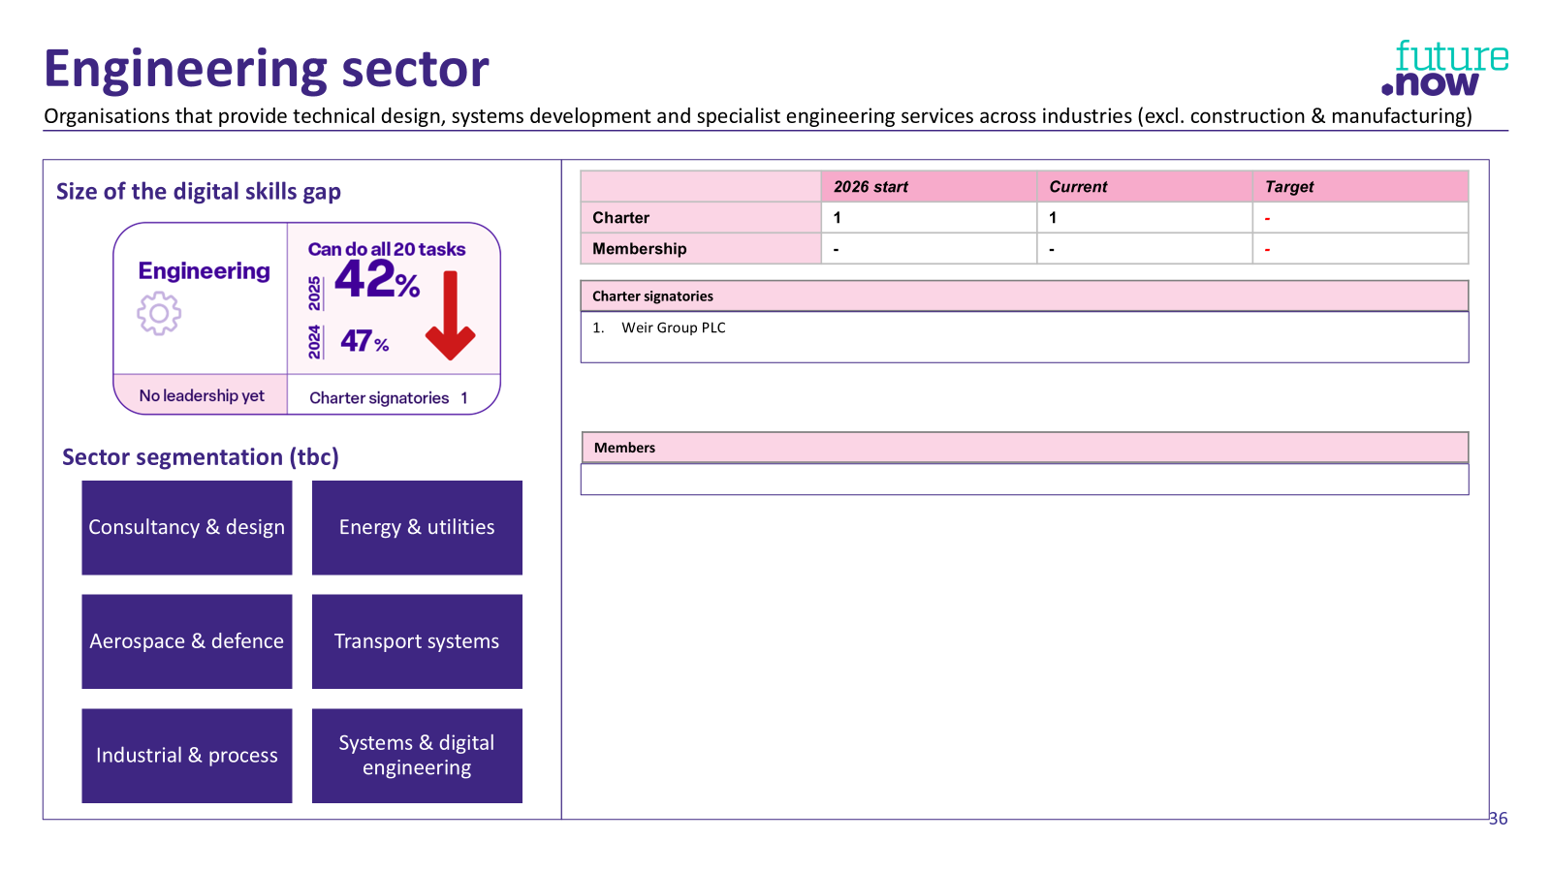
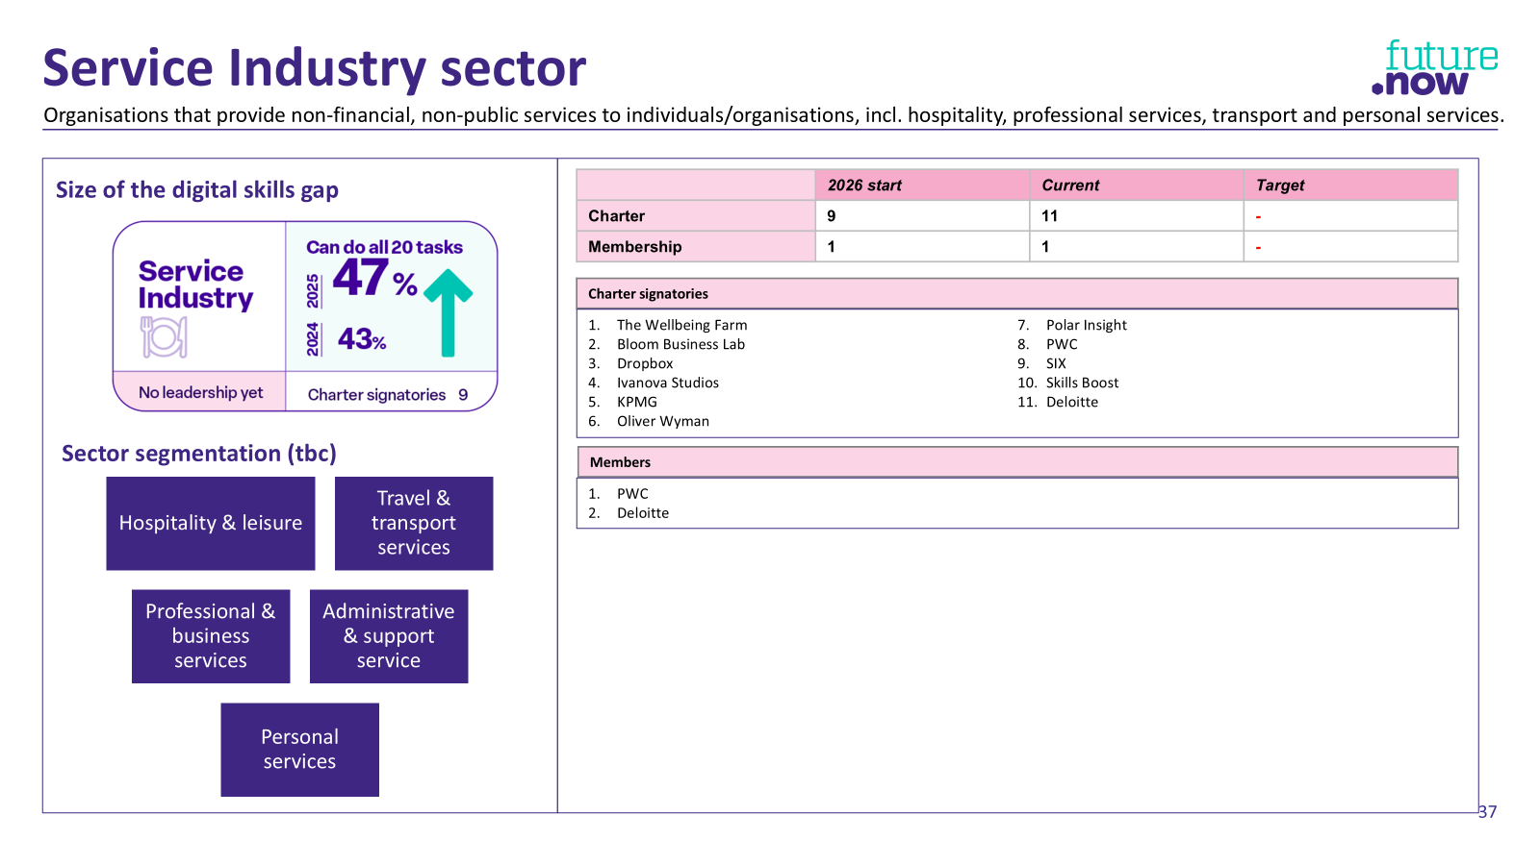
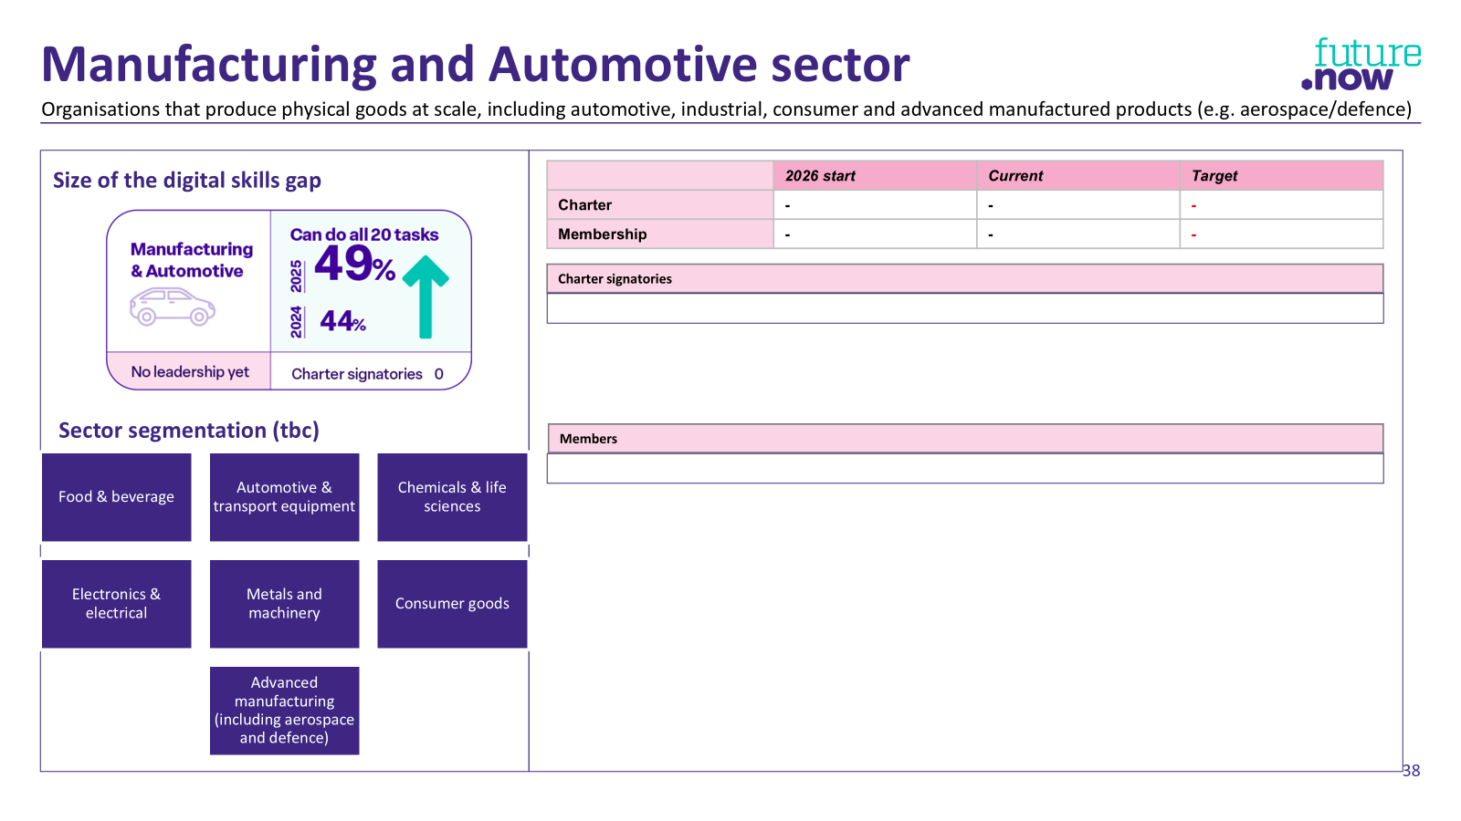
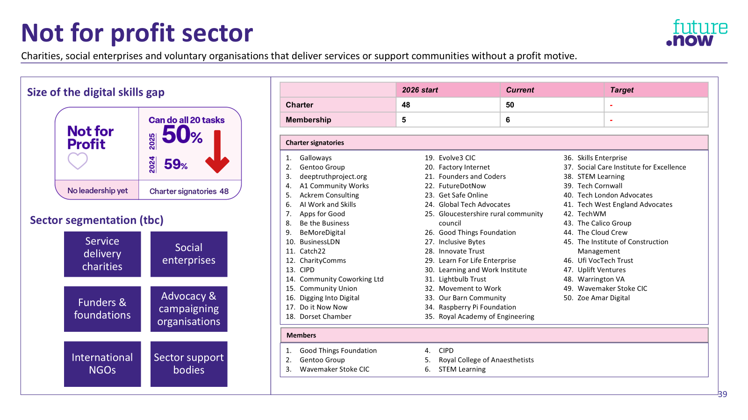
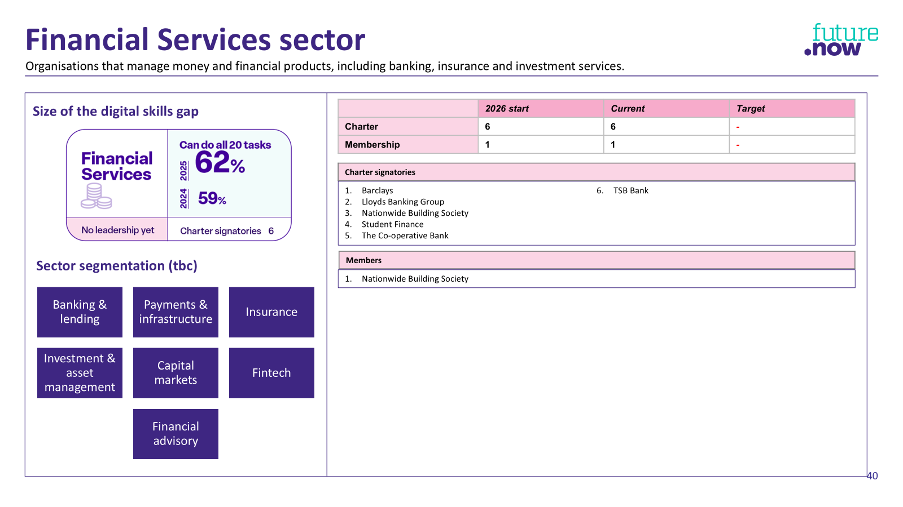
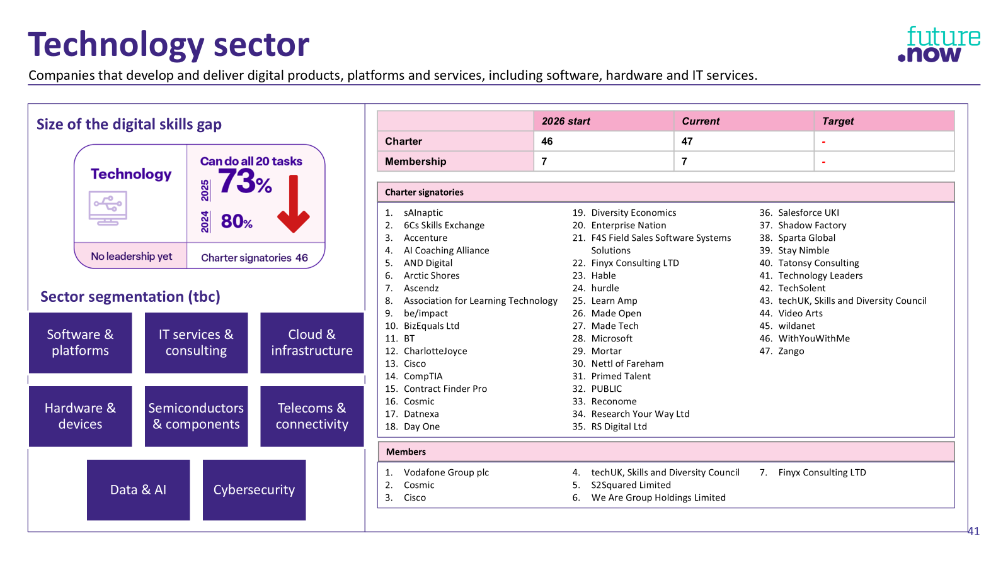
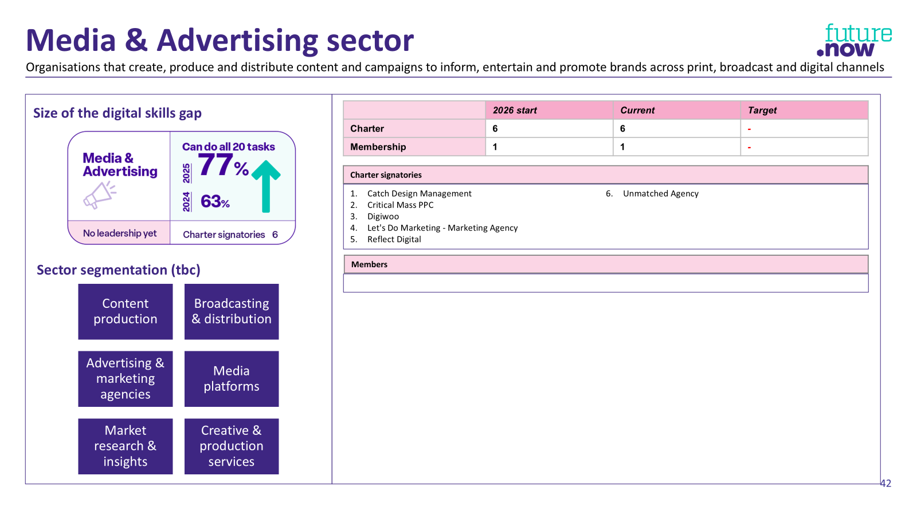
Sector information
More detail in the appendix on each sector, including:
Essential digital skills gap
Proposed sector segmentation
Charter signatories
Members

Slide 13

Let’s hear from the sector leads that are leading the way
NB: Sector classification from the Lloyds Bank Essential Digital Skills Report

Slide 14


Education Sector
Jon Hardman
Cheryl Swales

Slide 15
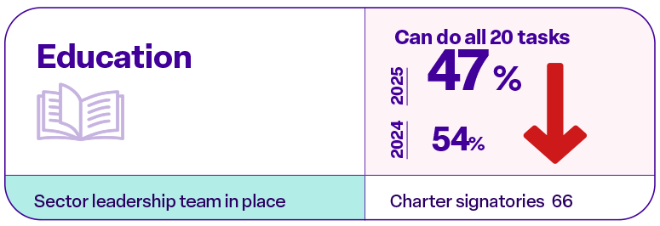
Education Sector
Providers of formal education and skills development, including schools, colleges and universities.
Size of the digital skills gap
Sector leadership from:
 | 2026 start | Current | Target
Charter | 61 | 68 | 110
Membership | 3 | 4 | TBC
Team members
Co-leads | Gateway Qualifications | Paul Saunders
 | AELP | Cheryl Swales
Team members | Gateway Qualifications | Jon Hardman
 | NCFE | Emzi Mills-Frater
 | City & Guilds | Paddy Craven
 | NCC Education | Helen Maxwell
 | AELP | Madhavi Kumar
Sector segmentation
Further Education (colleges)
Higher Education (universities)
Adult & community learning / skills providers
Work-based learning (apprenticeships, training providers)
Early years & primary education
Secondary schools

Slide 16
Education – Headline Action Plan
AMBITION | MOMENTUM SO FAR | SPRINT 2 PRIORITIES
By end 2026 we will: Make the workforce digital skills gap a recognised priority across Education Grow sector-wide commitment through Charter signatories and membership Position FutureDotNow as a trusted partner for workforce upskilling Demonstrate what good looks like through employer-led action in our own organisations | Reached 150+ sector stakeholders through flagship events and networks Established first case study to evidence impact Secured foothold in FE and HE sectors, and discussions underway with partners in other segments Initial upskilling activity underway (within Gateway Qualifications and AELP), with early baselining identifying workforce capability gaps | Scale reach through the channels and partners that engage the whole sector Convert awareness into commitment – growing Charter signatories and membership Expand beyond FE/HE to mobilise wider education segments (schools, ACL) Lead by example – demonstrating progress within our own organisations and sharing what works
Upcoming events
AELP conference HOLEX conference
Target prospects
HOLEX WEA NCC Education | Manchester Chamber of Commerce Tiro
Support needed
A5 flyer handout (email equivalent) introducing FutureDotNow, the issue why it matters, how we can help your organisation, what to do next Guidance/help to get the charter signed (benefits, who typically signs, common Qs, objection handling) Frequent slides to use in presentations Explainer videos
16

Slide 17


Construction & Infrastructure Sector
Naomi O’Neill
Jo Tasker

Slide 18
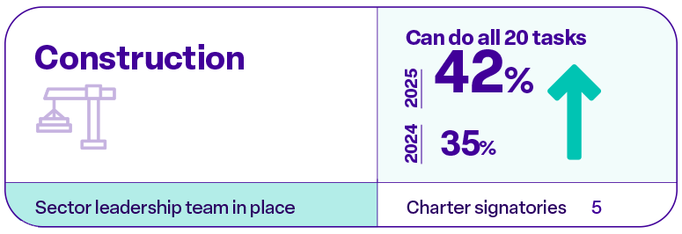

Construction & Infrastructure sector
Organisations that design, build and maintain physical infrastructure and the built environment.
Size of the digital skills gap
Sector leadership from:
 | 2026 start | Current | Target
Charter | 5 | 5 | 20
Membership | 1 | 1 | TBC
Team members
Co-leads | Amey | Naomi O’Neill
 | Bouygues Construction | Aurelie Marais
 | Community Coworking | Jo Tasker
Team members | Amey | TBC
 | Bouygues Construction | TBC
 | Community Coworking | TBC
Sector segmentation (tbc)
Contracting
Infrastructure
Property
Operations
Trades
Materials

Slide 19
Construction & Infrastructure – Headline Action Plan
AMBITION | MOMENTUM SO FAR | SPRINT 2 PRIORITIES
By end 2026 we will: Make the workforce digital skills gap visible and understood across the sector and supply chain Grow sector-wide commitment through Charter signatories and membership Position FutureDotNow as a partner to support workforce upskilling across construction and infrastructure Demonstrate what good looks like through employer-led action in our own organisations and supply chains | Sector leadership established with major employers (Amey, Bouygues), creating a credible platform for engagement Engagement underway through industry forums, taskforces and sector events Early collaboration across construction and infrastructure segments, including cross-industry initiatives (e.g. DfT-linked activity) Initial activity connecting digital skills to employability and supply chain needs (e.g. not-in-work pilots, training approaches) Growing focus on practical employer-led approaches (e.g. supply chain training models, “train the trainer” concepts) | Focus limited capacity on high-impact partnerships rather than broad event activity Prioritise collaborative projects to influence peers and demonstrate what works in practice Convert awareness into commitment – growing Charter signatories and membership Deepen engagement across construction, infrastructure and engineering segments Share learning from early activity and encourage adoption across the sector
Upcoming events/activity
Building the Future of Construction – 12th June Building digital skills requirements into contracts
Target prospects
Key Infrastructure providers – Network Rail, National Highways
Support needed
Working on additional resources from existing organisations – but any further help is greatly appreciated
19

Slide 20

Health & Care Sector
James Freed

Slide 21
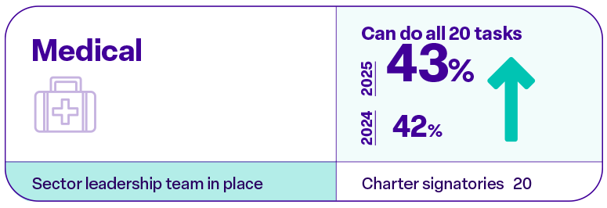



Health & Care sector
Providers of healthcare and clinical services, including hospitals, primary care and health systems.
Size of the digital skills gap
Sector leadership from:
 | 2026 start | Current | Target
Charter | 5 | 5 | 20
Membership | 1 | 1 | TBC
Team members
Co-leads | NHS England | James Freed
 | Skills for Care | Jane Brightman
 | Ramsay Health | Jo Dickson
 | RC of Surgeons | Clinician (tbc)
Team members | RC Anaesthetists | David Hunt
 | NHS England | Damola Lelaboye
Sector segmentation (tbc)
NHS
Adult Social Care
Independent healthcare
Future workforce

Slide 22
Health & Care – Headline Action Plan
AMBITION | MOMENTUM SO FAR | SPRINT 2 PRIORITIES
By end 2026 we will: Make the workforce digital skills gap a recognised priority across Health & Care Grow sector-wide commitment through Charter signatories and membership Position FutureDotNow as a trusted partner for workforce upskilling Demonstrate what good looks like through employer-led action in our own organisations | Strong leadership group established across NHS, social care and independent providers Engagement underway with key sector bodies (e.g. NHS, IHPN), building sector-wide alignment Early insight into workforce capability and sector needs emerging through surveys and engagement Initial employer-led action underway: NHS business case for digital skills investment developed Independent providers beginning to share learning and approaches (e.g. Ramsay collaboration) Social care exploring integration into innovation and workforce development activity | Scale reach through established sector channels (NHS, IHPN, professional bodies) Convert awareness into commitment – growing Charter signatories and membership Strengthen engagement across key segments (NHS, social care, independent providers) Lead by example – demonstrating progress within our own organisations and sharing what works Translate early activity into scalable, repeatable approaches and share learning across the sector
22

Slide 23


Government Sector
Jonathan Foreman
Thomas Beautyman

Slide 24
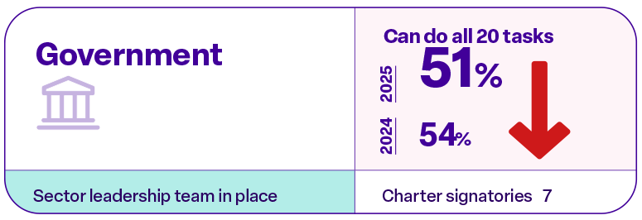

Government sector
Central and devolved government departments responsible for policy, administration and national public services.
Size of the digital skills gap
Sector leadership from:
 | 2026 start | Current | Target
Charter | 20 | 21 | 70
Membership | 1 | 1 | TBC
Team members
Co-leads | Home Office | Laura Gregory
 | DSIT | Thomas Beautyman
 | Cabinet Office (Govt Skills Unit) | Jonathan Forman
Team members | Cabinet Office (Govt Skills Unit) | Philip Wilson
 |  | TBC
 |  | TBC
Sector segmentation (tbc)
Central government departments and arms-lengths bodies
Local government
Justice, defence & public safety

Slide 25
Government – Action Plan
AMBITION | MOMENTUM SO FAR | SPRINT 2 PRIORITIES
By end 2026 we will: Position workforce digital skills as a core capability across government Grow commitment through Charter signatories and membership across public sector organisations Position digital skills as critical to government priorities (productivity, service delivery, AI) Demonstrate what good looks like through action within our own organisations Launch the National School for Government and Public Services (all civil servants will be offered AI training through the National School) | Initial cross-government leadership group established (Home Office, DSIT, Cabinet Office) Clear policy alignment emerging, positioning digital skills as a baseline capability for all public servants Strong narrative developing linking digital skills to productivity, service quality, AI adoption and risk management Early progress in defining sector scope, with initial focus on different civil servant segments Foundations in place to begin structured engagement across departments and functions | Complete review of the AI-embedded Essential Digital Skills Framework and confirm its importance for civil servants in non-data and digital roles. Clarify key stakeholders to engage and the case for action Identify opportunities to embed digital skills within core government priorities (productivity, service delivery, AI) – both directly and by supporting FutureDotNow campaigning efforts Convert interest into commitment - growing Charter signatories and membership Lead by example - demonstrate progress within own departments
25

Slide 26
Enablers:
Making action easier
Notes:
Tools and solutions
Solving systemic issues
Test and learn projects

Slide 27

Enablers: Making action easier
Two interdependent workstreams, both led from within the FutureDotNow core team, are focused on helping organisations understand the essential digital skills gap and taking action:
Benchmarking. Helping organisations benchmark their position using the Organisational Maturity Framework
Tools and Solutions. Curating tools and solutions aligned to the different stages in the Maturity Framework.
The Essential Digital Skills Organisational Maturity Framework
PREPARATION
ACTIVE COMMITMENT
REALISATION & EMBEDDING
STAGE 1
STAGE 2
STAGE 3
STAGE 4
STAGE 5
Identifying starting point and digital skill levels within organisation
Building business case and developing senior support
Designing programme
Implementing programme
Testing, improving and scaling programme
Tools and solutions to help business take action
Tools & Solutions will be led by FutureDotNow and the focus of new Marketing Lead once in post (starting 22 June)
Notes:
HOLLY

Slide 28
Enablers: Solving systemic issues
We also have 2 workstreams focused on addressing systemic issues:
Accreditation and badging
New for sprint 2, this builds on work developed for the Employability workstream. Team brings together:
  UFI VocTechTrust
  City & Guilds
  iDEA Foundation
  Navigatr
  FutureDotNow
Future-fit Work Skills Framework
Notes:
HOLLY

Slide 29



Future-fit Work Skills Framework
Leadership from:
Team
Co-leads | Alan Turing Institute | Dr Matt Forshaw
 | Lancashire Skills and Employment Hub | Kerry Harrison
 | FutureDotNow | Holly Chate
Team members | Amey | Jeff Colclough
 | City & Guilds | Patrick Craven
 | Department for Education | Kathleen Gristock
 | Swansea University | Megan Venn-Wycherley
Notes:
JON

Slide 30
Future-fit Work Skills Framework
AMBITION | MOMENTUM SO FAR | SPRINT 2 PRIORITIES
EDS Framework ownership is resolved​. An appropriate review process is proposed that ensures the framework keeps pace with tech developments (e.g. AI).​ | Essential Digital Skills Framework now under DSIT stewardship. | FRAMEWORK Watching brief re: DSIT stewardship, and what this means for the framework updates and annual reporting. Anticipate a request to support in some capacity. LANGUAGE Conduct a rapid review of the AI-embedded Essential Digital Skills framework and the proposed amends to ensure the language aligns with appropriate reading age for employability programmes.
Framework is better positioned into the wider picture of standards, qualifications and curriculum​ | Team has joined calls with Skills England, DWP, DfE and DSIT re alignment across the disconnected and fragmented AI skills landscape | ECOSYSTEM Continue to monitor the ecosystem of players and skills frameworks and advocate for wider adoption of and alignment with the AI-embedded Essential Digital Skills Framework wherever possible
Framework is recognised and adopted by industry and government as the digital skills baseline for workers.​ Framework is more actionable, accessible and relevant to different business audiences.​ | Scoped support for AI leadership and the Level 4 AI apprenticeship and began creating an adoption package and clear core offer. Identified routes to integrate FutureDotNow materials into teaching, including links to the Charter and self-assessment tool. Created provider invitation materials and progressed a clear, reusable narrative and comms assets to support consistent partner engagement. | TEST & LEARN PROJECT: Engage training providers as a scale route to reach both future talent and current leaders, using new AI apprenticeships as the entry point to embed the importance of workforce digital skills into both technical and leadership training. Map and embed FutureDotNow into existing training pathways, identify where the mission aligns with apprenticeship standards (KSBs) and integrate Charter, evidence and tools without requiring curriculum redesign. Develop and test scalable assets, then active across the provider network, create light-touch teaching materials and deliver a targeted briefing/webinar to drive adoption, Charter sign-ups and use of FutureDotNow tools at scale.
Notes:
PAUL

Slide 31
What’s next
Notes:
HOLLY

Slide 32
What’s next
Co-leads:
Reconfirm your Sprint 2 priorities. Has anything changed since the Summit?
Reconfirm workstream roles and responsibilities
Get your meetings in the diary and convene your team at least once before 23 June. Get work underway!
Be ready to share updates at the mid-point connect (23 June).
Team members:
Look out for team meetings
Help shape the priorities for Sprint 2
Be clear on what you can deliver
Be part of driving the progress!
Three key dates for your diary
Sprint 2: 10 weeks (26 May to 28 July)
25-May | 1-Jun | 8-Jun | 15-Jun | 22-Jun | 29-Jun | 6-Jul | 13-Jul | 20-Jul | 27-Jul
1 | 2 | 3 | 4 | 5 | 6 | 7 | 8 | 9 | 10
Sprint Kick-Off TODAY |  |  |  | Mid-point connect 23 Jun |  |  |  |  | End of sprint workshop 28 July
Kick-Off call – 26 May
Objective: Share goals for the next 10 weeks, orientate teams on what’s needed, answer any Qs. Energise us all for this next sprint.
Format: Virtual
When: 26 May, 14:00 – 15:00
Mid-point connect – 23 June
Objective: Share progress against outcomes, spot interdependencies and manage risks.
Format: Virtual
When: 23 June, 14:00 – 15:30
  End of Sprint Workshop – 28 July
Objective: Review outcomes, successes and next steps. Celebrate progress, and energise teams for the next sprint
Format: In-person
When: 28 July 14:00 – 17:00
Where: techUK, London EC4A
Notes:
PAUL

Slide 33
Campaigning
Keeping attention on the need to supercharge essential digital skills in working age adults.
Notes:
Liz

Slide 34
Keep attention on the essential digital skills gap
Workforce Digital Skills Summit
Employability pilot MP engagement
Co-creating plan to socialise learnings with policy makers
Ofcom media literacy
Essential Digital Skills Framework DSIT ownership
Skills England Standard Skills Classification (SSC) to include essential digital skills for work
DfE Essential Digital Skills Standards consultation
Engaging the HR community with CIPD
Business and Trade Select Committee on AI and the Future of Work
(available from website)
And a refreshed website
Coming next…
Work ready in age of AI Report - Thursday
Chatham House closed roundtable on AI, work and the future of global competitiveness
Digital Skills Council: Input to Digital jobs plan
DSIT engagement on EDS framework next steps
Potential white paper on whole workforce digital upskilling
Employability learning socialisation with policy makers
London Tech Week partner briefing - this week

Slide 35

Have a great sprint all
Any questions?
If you’re not yet involved, email us hello@futuredotnow.uk and we’ll join you with a workstream
Next meeting: Mid-point connect:
23 June at 2:00-3:30pm. Virtual.
Come ready to share progress headlines
End of sprint workshop:
28 July at 2:00-5:00pm. At techUK.
Don’t forget to download and share your sprint 1 badges

Slide 36
Supporting slides

Slide 37
Best practice guidance on mobilising a workstream
The following learning is output from work over the last two years. It is not definitive and is offered as stimulus to help you shape what works best for your team, whilst avoiding the pitfalls others have navigated.
WHAT WORKS
WHAT DOESN’T
Involve the full team when you can.
Who has capacity or specific skills or expertise?
Sub-teams work; share responsibility and ownership across the team
Agree meeting cadance at the start and schedule meetings in early across the sprint
Meeting cadance depends on your outcomes:
  Workshops; 2-2.5 hrs. greater
  collaboration and idea generation
  Fortnightly check-ins at a fixed time; work well for sub-teams and iterative work
Use transcription and AI summary to capture
notes and actions
    Shared document storage doesn’t work. Multiple organisations/ teams mean multiple fire-walls.
    ANSWER: Work real-time. What can be done live
    in meetings/workshops? Share quick email updates and transfer to a master document.
    Don’t let ‘perfect’ be the enemy of progress
    ANSWER: Get comfortable showing your working out. Share ideas quickly and frequently to make progress and course correct if needed.

Slide 38
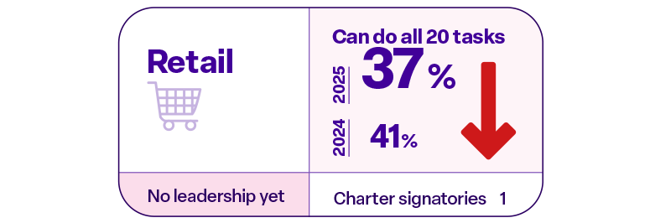
Retail sector
Organisations that sell goods directly to consumers across physical, online and blended channels.
Size of the digital skills gap
 | 2026 start | Current | Target
Charter | 1 | 1 | -
Membership | 1 | 1 | -
Charter signatories
M&S
Members
Holland & Barratt
Sector segmentation (tbc)
Food stores
Department stores
Other non-food stores
Textile, clothing and footwear stores
Household goods stores
Non-store retailing
Automotive
fuel

Slide 39
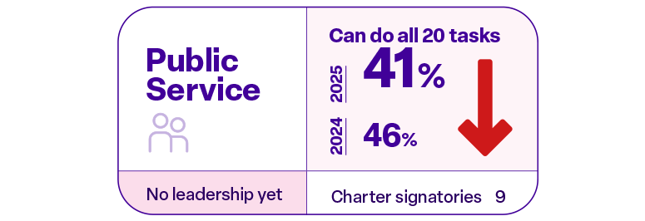
Public Services sector
Frontline public services delivered primarily by local authorities, emergency services and civic institutions, excluding health, education and central government.
Size of the digital skills gap
 | 2026 start | Current | Target
Charter | 9 | 9 | -
Membership | 2 | 2 | -
Charter signatories
Behavioural Insights Ltd
City of London
City of Wolverhampton Council
Cornwall Council
Kingston Council
Leeds City Council
London Transport Museum
Nominet
The South East Local Enterprise Partnership
Sector segmentation (tbc)
Members
Emergency & justice services
Local authority services
Social care & community services
Public service delivery organisations & civic institutions
The Crown Estate
Whiteinch and Scotstoun Housing Association

Slide 40
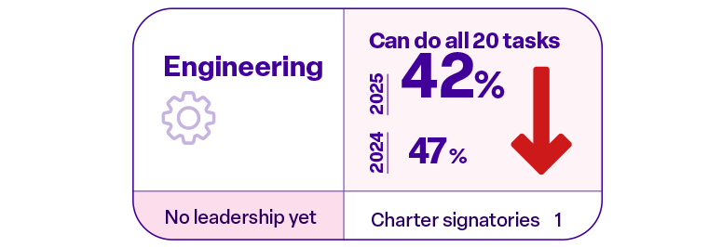
Engineering sector
Organisations that provide technical design, systems development and specialist engineering services across industries (excl. construction & manufacturing)
Size of the digital skills gap
 | 2026 start | Current | Target
Charter | 1 | 1 | -
Membership | - | - | -
Charter signatories
Weir Group PLC
Sector segmentation (tbc)
Members
Consultancy & design
Energy & utilities
Aerospace & defence
Transport systems
Industrial & process
Systems & digital engineering

Slide 41
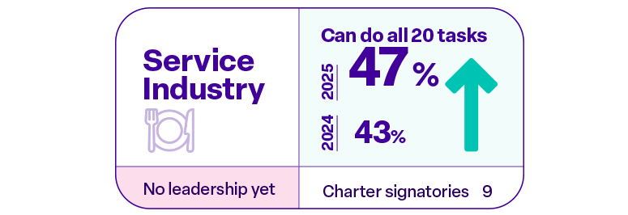
Service Industry sector
Organisations that provide non-financial, non-public services to individuals/organisations, incl. hospitality, professional services, transport and personal services.
Size of the digital skills gap
 | 2026 start | Current | Target
Charter | 9 | 11 | -
Membership | 1 | 1 | -
Charter signatories
The Wellbeing Farm
Bloom Business Lab
Dropbox
Ivanova Studios
KPMG
Oliver Wyman
Polar Insight
PWC
SIX
Skills Boost
Deloitte
Sector segmentation (tbc)
Members
Hospitality & leisure
Travel & transport services
Professional & business services
Administrative & support service
Personal services
PWC
Deloitte

Slide 42
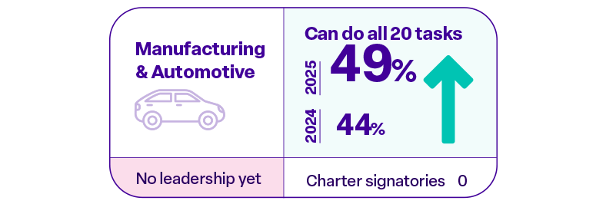
Manufacturing and Automotive sector
Organisations that produce physical goods at scale, including automotive, industrial, consumer and advanced manufactured products (e.g. aerospace/defence)
Size of the digital skills gap
 | 2026 start | Current | Target
Charter | - | - | -
Membership | - | - | -
Charter signatories
Sector segmentation (tbc)
Members
Food & beverage
Automotive & transport equipment
Chemicals & life sciences
Electronics & electrical
Metals and machinery
Consumer goods
Advanced manufacturing (including aerospace and defence)

Slide 43
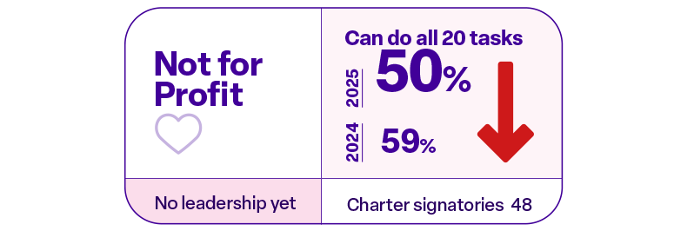
Not for profit sector
Charities, social enterprises and voluntary organisations that deliver services or support communities without a profit motive.
Size of the digital skills gap
 | 2026 start | Current | Target
Charter | 48 | 50 | -
Membership | 5 | 6 | -
Charter signatories
Galloways
Gentoo Group
deeptruthproject.org
A1 Community Works
Ackrem Consulting
AI Work and Skills
Apps for Good
Be the Business
BeMoreDigital
BusinessLDN
Catch22
CharityComms
CIPD
Community Coworking Ltd
Community Union
Digging Into Digital
Do it Now Now
Dorset Chamber
Evolve3 CIC
Factory Internet
Founders and Coders
FutureDotNow
Get Safe Online
Global Tech Advocates
Gloucestershire rural community council
Good Things Foundation
Inclusive Bytes
Innovate Trust
Learn For Life Enterprise
Learning and Work Institute
Lightbulb Trust
Movement to Work
Our Barn Community
Raspberry Pi Foundation
Royal Academy of Engineering
Skills Enterprise
Social Care Institute for Excellence
STEM Learning
Tech Cornwall
Tech London Advocates
Tech West England Advocates
TechWM
The Calico Group
The Cloud Crew
The Institute of Construction Management
Ufi VocTech Trust
Uplift Ventures
Warrington VA
Wavemaker Stoke CIC
Zoe Amar Digital
Sector segmentation (tbc)
Service delivery charities
Social enterprises
Funders & foundations
Advocacy & campaigning organisations
International NGOs
Sector support bodies
Members
Good Things Foundation
Gentoo Group
Wavemaker Stoke CIC
CIPD
Royal College of Anaesthetists
STEM Learning

Slide 44
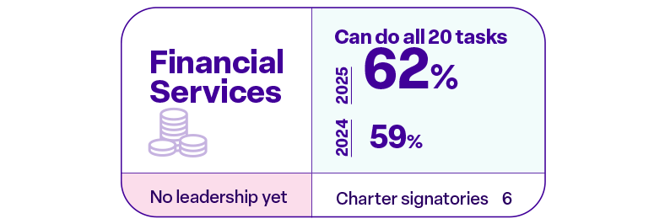
Financial Services sector
Organisations that manage money and financial products, including banking, insurance and investment services.
Size of the digital skills gap
 | 2026 start | Current | Target
Charter | 6 | 6 | -
Membership | 1 | 1 | -
Charter signatories
Barclays
Lloyds Banking Group
Nationwide Building Society
Student Finance
The Co-operative Bank
TSB Bank
Sector segmentation (tbc)
Members
Banking & lending
Payments & infrastructure
Insurance
Investment & asset management
Capital markets
Fintech
Financial advisory
Nationwide Building Society

Slide 45

Technology sector
Companies that develop and deliver digital products, platforms and services, including software, hardware and IT services.
Size of the digital skills gap
 | 2026 start | Current | Target
Charter | 46 | 47 | -
Membership | 7 | 7 | -
Charter signatories
sAInaptic
6Cs Skills Exchange
Accenture
AI Coaching Alliance
AND Digital
Arctic Shores
Ascendz
Association for Learning Technology
be/impact
BizEquals Ltd
BT
CharlotteJoyce
Cisco
CompTIA
Contract Finder Pro
Cosmic
Datnexa
Day One
Diversity Economics
Enterprise Nation
F4S Field Sales Software Systems Solutions
Finyx Consulting LTD
Hable
hurdle
Learn Amp
Made Open
Made Tech
Microsoft
Mortar
Nettl of Fareham
Primed Talent
PUBLIC
Reconome
Research Your Way Ltd
RS Digital Ltd
Salesforce UKI
Shadow Factory
Sparta Global
Stay Nimble
Tatonsy Consulting
Technology Leaders
TechSolent
techUK, Skills and Diversity Council
Video Arts
wildanet
WithYouWithMe
Zango
Sector segmentation (tbc)
Software & platforms
IT services & consulting
Cloud & infrastructure
Hardware & devices
Semiconductors & components
Telecoms & connectivity
Data & AI
Cybersecurity
Members
Vodafone Group plc
Cosmic
Cisco
techUK, Skills and Diversity Council
S2Squared Limited
We Are Group Holdings Limited
Finyx Consulting LTD

Slide 46
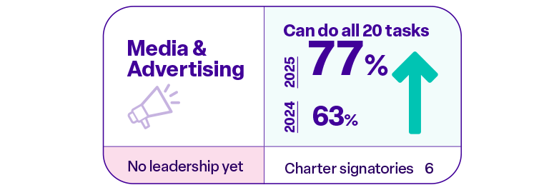
Media & Advertising sector
Organisations that create, produce and distribute content and campaigns to inform, entertain and promote brands across print, broadcast and digital channels
Size of the digital skills gap
 | 2026 start | Current | Target
Charter | 6 | 6 | -
Membership | 1 | 1 | -
Charter signatories
Catch Design Management
Critical Mass PPC
Digiwoo
Let's Do Marketing - Marketing Agency
Reflect Digital
Unmatched Agency
Sector segmentation (tbc)
Members
Content production
Broadcasting & distribution
Advertising & marketing agencies
Media platforms
Market research & insights
Creative & production services

